Slide 1


Use Case for Window Function
Running & Rolling Total

Slide 2

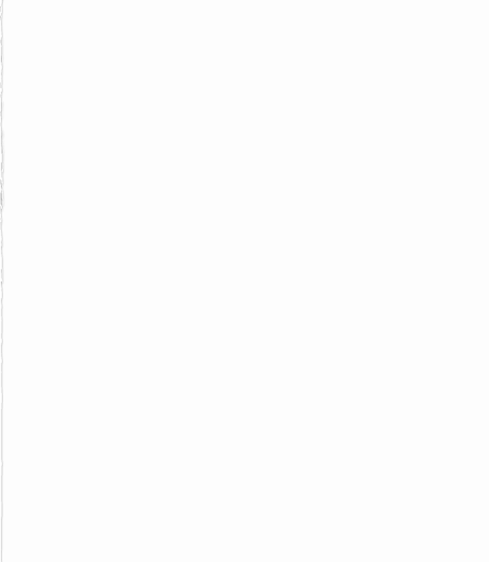
What is Window Function ?
"Window functions add analytical power to SQL by computing values across rows while keeping individual rows visible."

Slide 3
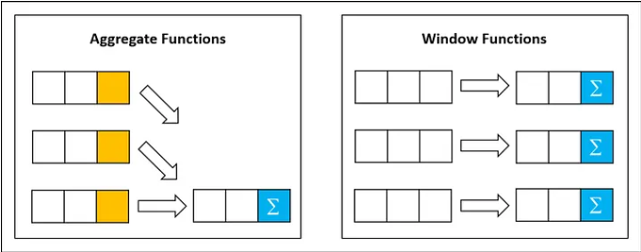
Difference b/w Group by and Window Function

Slide 4

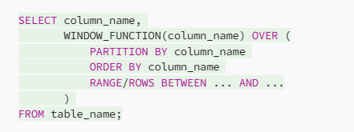
Structure of Window Function

Slide 5
To Specify Window Frame:
The bounds can be any of these five options:
UNBOUNDED PRECEDING – All rows before the current row.
n PRECEDING – n rows before the current row.
CURRENT ROW – Just the current row.
n FOLLOWING – n rows after the current row.
UNBOUNDED FOLLOWING – All rows after the current row.

Slide 6
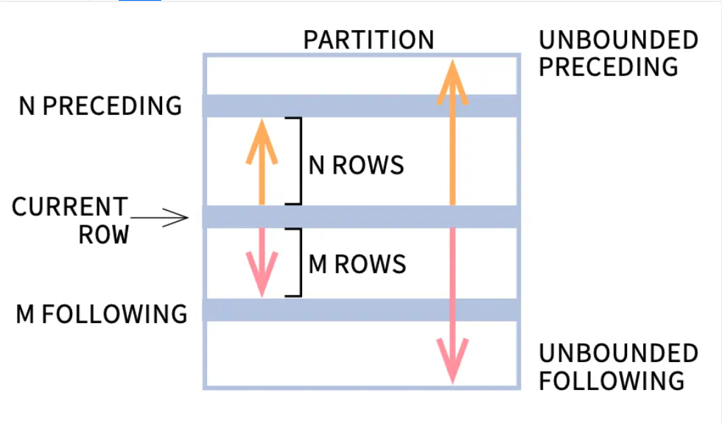

Slide 7
Running & Rolling Total
Running
A running total, also known as a cumulative sum, is the summation of a sequence of numbers which is updated each time a new number is added to the sequence, by adding the value of the new number to the previous running total
Rolling
Calculates a sum over a "window" or subset of rows that moves through the result set. It is used to see how trends change over time, giving a clear picture of your data.

Slide 8
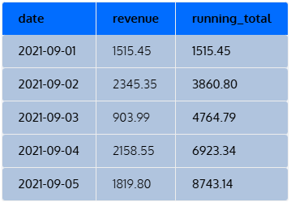
Running Total Example we want to add another column that shows the total revenue from the first date up to the current row’s date (i.e. running total).
SELECT date, revenue,
SUM(revenue) OVER (
ORDER BY date) running_sum
FROM sales
ORDER BY date;

Slide 9
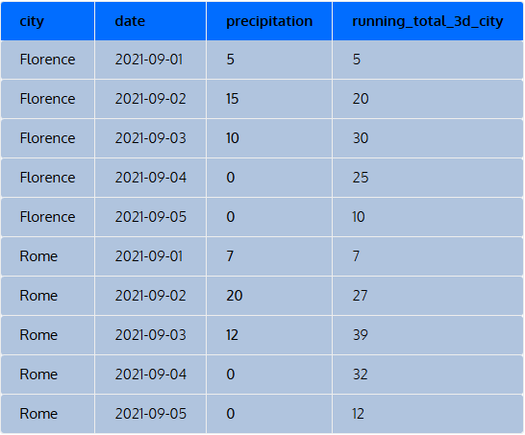
Rolling Total Example calculate the total precipitation for the last three days (i.e. a three-day running total) separately for two cities.
SELECT city, date, precipitation,
SUM(precipitation) OVER (
PARTITION BY city
ORDER BY date
ROWS 2 PRECEDING) running_total_3d_city
FROM weather
ORDER BY city, date;

